Slide 1
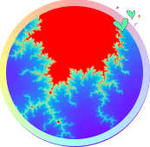
重庆大学
C++编程基础及应用
第4章 分支与循环
高等教育出版社 第1版
重庆大学 海洋饼干叔叔
使用WPS播放效果最佳

Slide 2



计算机只能完成赋值、输入输出、逻辑判断、分支、循环等基本任务。借助软件，软件工程师可以将这些基本任务进行组合，在计算机极高的运算速度的加持下，完成诸如“在一堆动物照片里找出加菲猫”等复杂任务。软件工程师的角色类似于上帝，他们赋予机器灵魂。
——编者
Chinese God

Slide 3
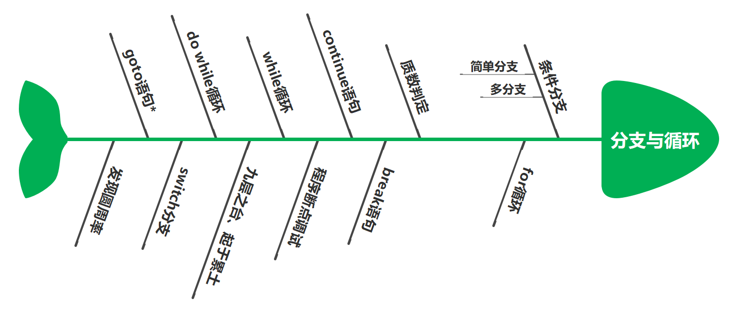
4. 分支与循环

Slide 4

4.1 if else语句
如果... 就...
if (表达式)
语句;
if (表达式) {
语句;
...
语句;
}
<条件> ?
否
是
语句块

Slide 5
4.1 if else语句
执行结果
Hey, how old are you ? boy. 23 You are legally an adult. Congratulations, son! You are of legal age for marriage.
//Project - IfStatement
#include <iostream>
using namespace std;
int main(){
int iAge = 0;
cout << "Hey, how old are you ? boy.\n";
cin >> iAge;
if (iAge>=18) //括号()必须
cout << "You are legally an adult.\n";
if (iAge>=22){
cout << "Congratulations, son!\n";
cout << "You are of legal age for marriage.\n";
}
return 0;
}
输入不同，结果可能不同。

Slide 6
4.1 if else语句
if (表达式)
语句；
else
语句；
if (表达式) {
语句；
...
语句；
}
else {
语句；
...
语句；
}
<条件> ?
否
是
if下方语句块
else下方语句块

Slide 7
4.1 if else语句
执行结果
Please enter the year: 2021 2021 is not leap year.
//Project - IfElseStatement
#include <iostream>
using namespace std;
int main() {
int iYear {};
cout << "Please enter the year:" << endl;
cin >> iYear;
if ((iYear%4==0 && iYear%100!=0) || (iYear%400==0)){
cout << iYear << " is leap year." << endl;
cout << "There are 29 days in February of " << iYear << ".\n";
}
else
cout << iYear << " is not leap year." << endl;
return 0;
}
执行结果
Please enter the year: 2020 2020 is leap year. There are 29 days in February of 2020.
年份满足下述条件之一，即为闰年：
①能被4整除且不能被100整除；
②能被400整除。
四年一闰，百年不闰，四百年再闰。

Slide 8
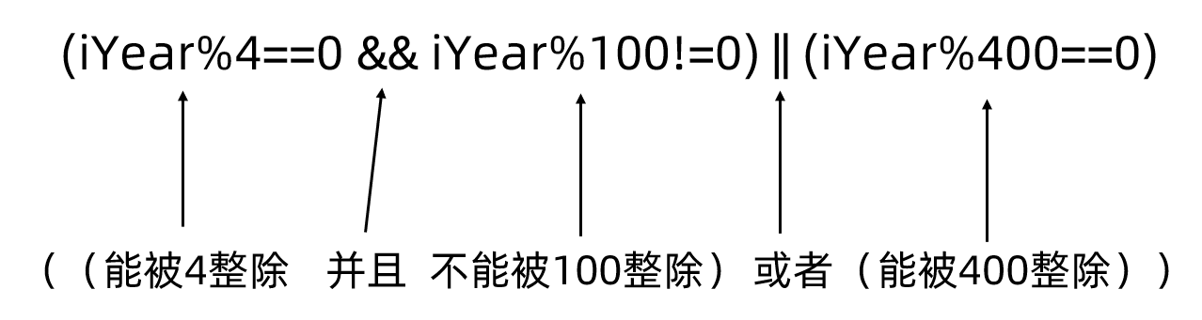
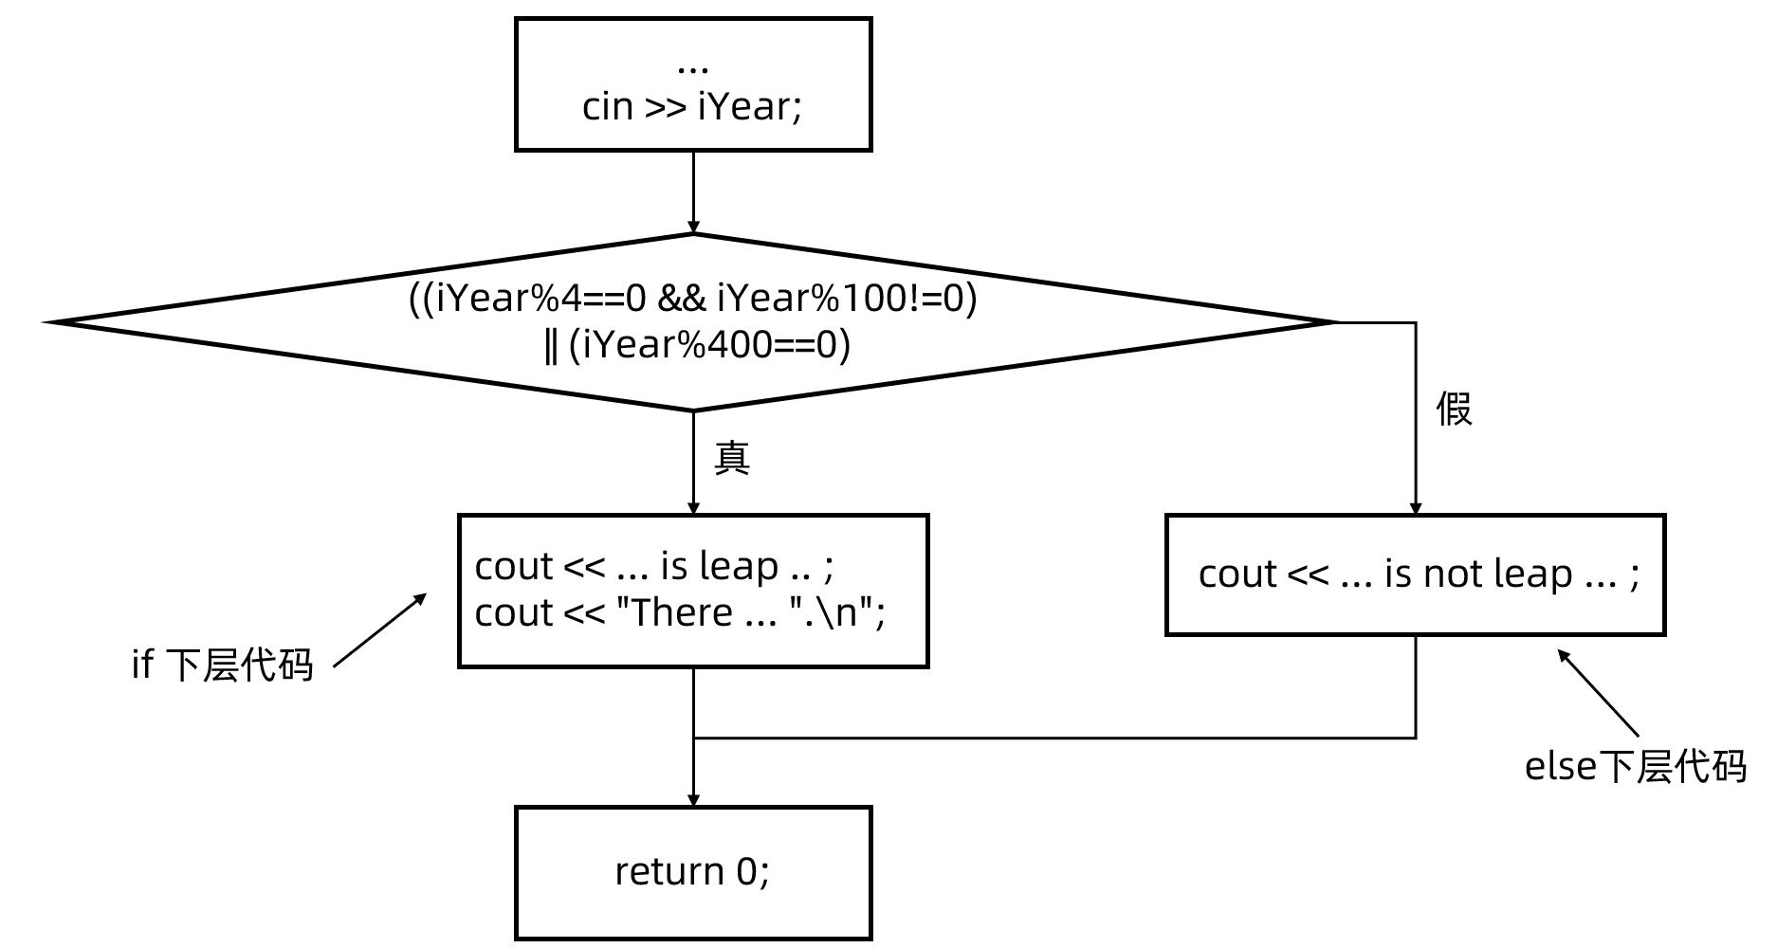
4.1 if else语句

Slide 9
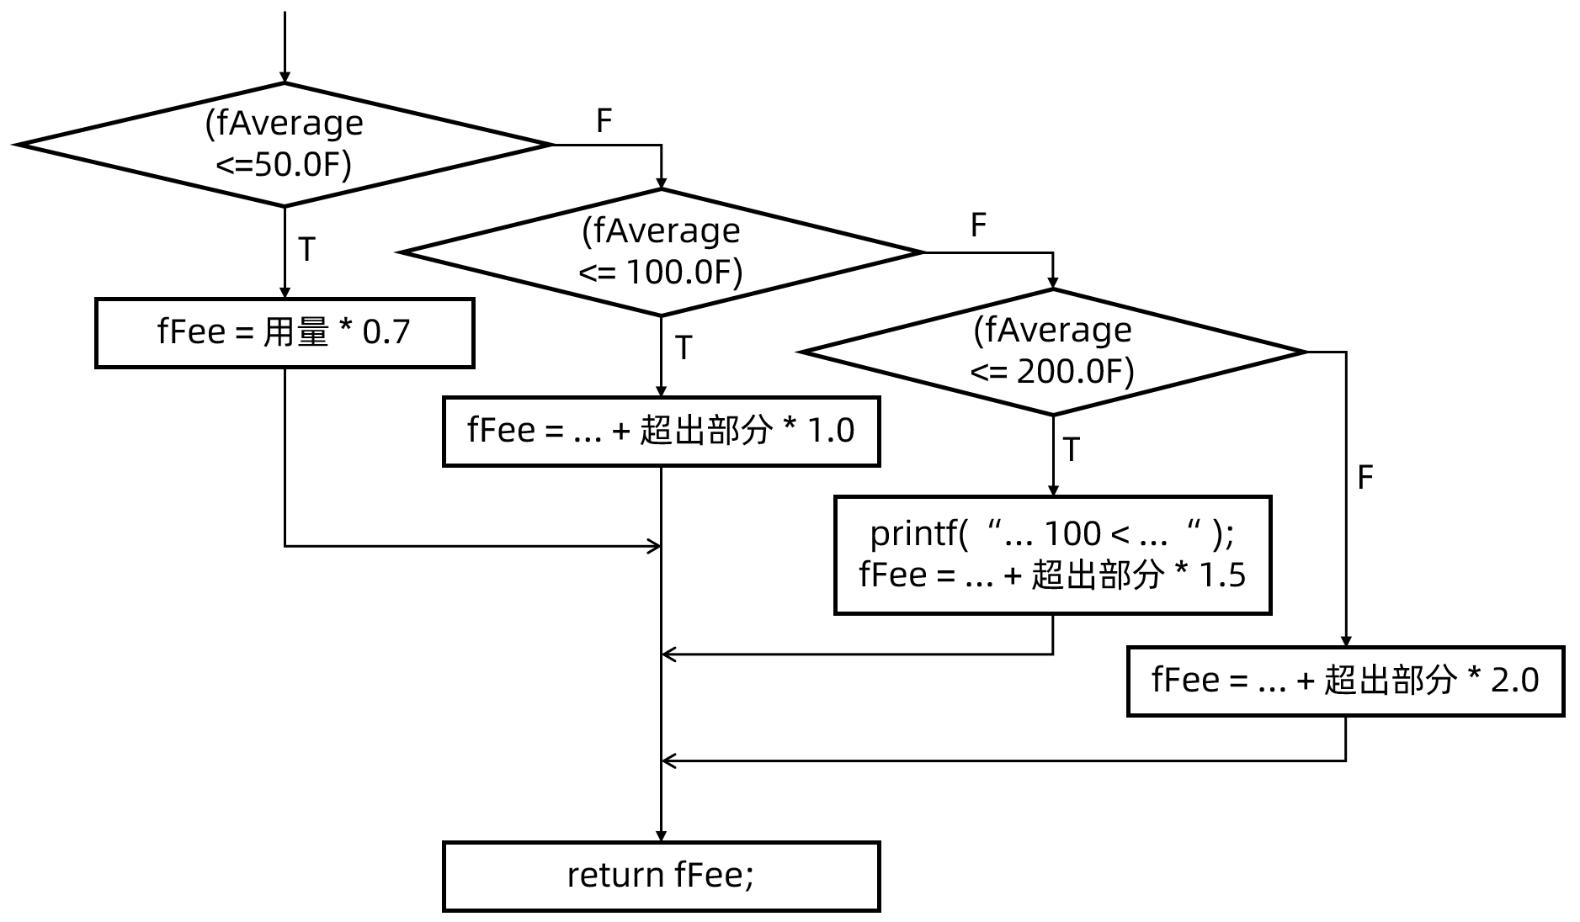
阶梯电价政策：以家庭为计价单位，每位家庭成员享有50度/月的基准用电量。
• 人均月用电量 ≤ 50度，电价按0.7元/度执行；
• 50度 < 人均月用电量 ≤ 100度，基准用电量部分按0.7元/度执行， 超出部分按1.0元/度执行；
• 100度 < 人均月用电量 ≤ 200度，基准用电量部分按0.7元/度执行， 超出部分按1.5元/度执行；
• 人均月用电量 > 200度，基准用电量部分按0.7元/度执行， 超出部分按2.0元/度执行；
4.2 多分支选择

Slide 10
4.2 多分支选择
//Project - ElseIfStatement
#include <cstdio>
float feeCompute(float fAmount, int iPersonCount){
float fAverage = fAmount / iPersonCount; //人均用电量
float fFamilyBaseAmt = iPersonCount * 50.0F; //家庭基准用电量
float fFee = 0; //家庭电费
if (fAverage <=50.0F)
fFee = fAmount * 0.7F;
else if (fAverage <= 100.0F)
fFee = (fAmount - fFamilyBaseAmt) * 1.0F + fFamilyBaseAmt * 0.7F;
else if (fAverage <= 200.0F) {
printf("Inside function feeCompute: 100 < Average <= 200.\n");
fFee = (fAmount - fFamilyBaseAmt) * 1.5F + fFamilyBaseAmt * 0.7F;
}
else
fFee = (fAmount - fFamilyBaseAmt) * 2.0F + fFamilyBaseAmt * 0.7F;
return fFee;
}

Slide 11
4.2 多分支选择
int main(){
float fFee =feeCompute(768.1F, 4);
printf("Energy used: %.2f kWh, Person count: %d, Electricity bill: %.2f\n",
768.1F,4,fFee);
return 0;
}
执行结果
Inside function feeCompute: 100 < Average <= 200. Energy used: 768.10 kWh, Person count: 4, Electricity bill: 992.15

Slide 12
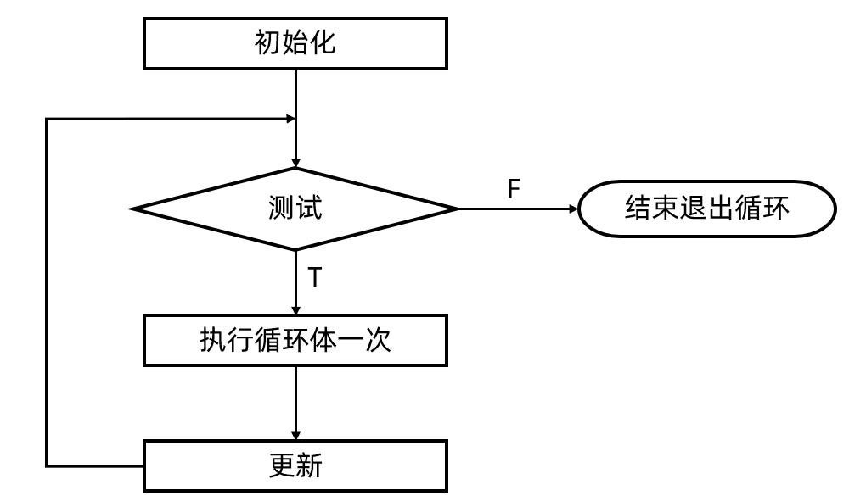
4.3.1 传统for循环
for (初始化；测试；更新)
语句;
for (初始化；测试；更新) {
语句;
...
语句;
}
初始化语句（initialization）： 初始化用于循环控制的变量；
测试表达式（test expression）：进行循环测试，一般为一个逻辑判断表达式；
更新表达式（update expression）: 修改用于循环测试的变量。注意该表达式尾部没有分号。

Slide 13
执行结果
loop i = 0 loop i = 1 loop i = 2 sum = 3
4.3.1 传统for循环
//Project - SimplestFor
#include <iostream>
using namespace std;
int main() {
int iSum = 0;
for (int i=0;i<3;i++){
cout << "loop i = " << i << endl;
iSum += i;
}
cout << "sum = " << iSum;
return 0;
}

Slide 14
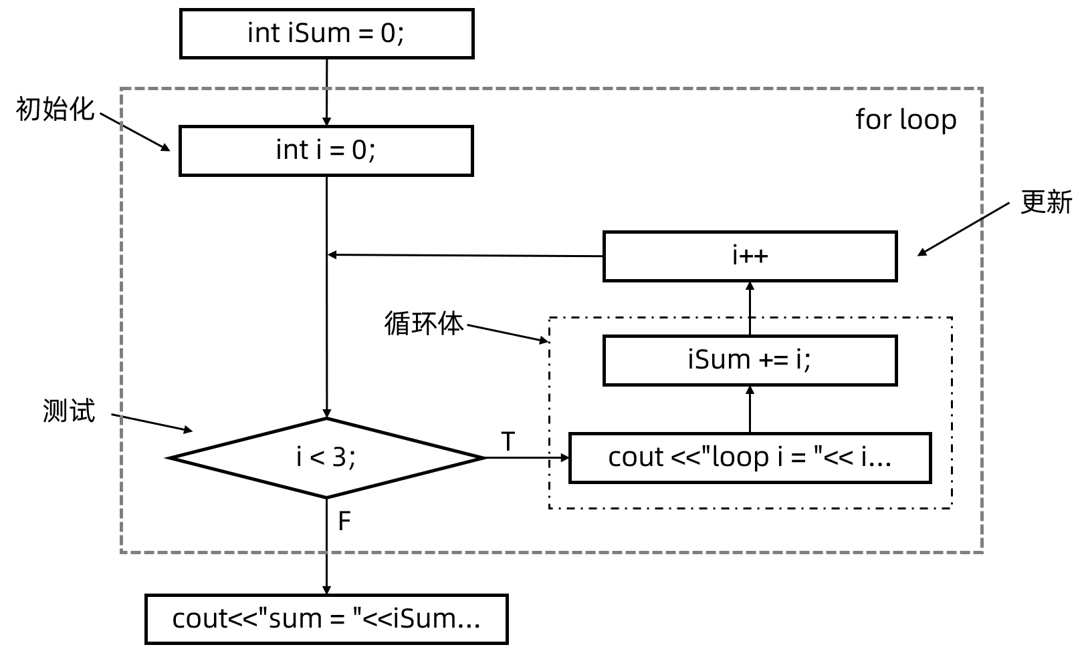
4.3.1 传统for循环
//Project - SimplestFor
#include <iostream>
using namespace std;
int main() {
int iSum = 0;
for (int i=0;i<3;i++){
cout << "loop i = " << i << endl;
iSum += i;
}
cout << "sum = " << iSum;
return 0;
}

Slide 15
4.3.1 传统for循环
//Project - Sum100
#include <iostream>
using namespace std;
int main(){
int iSum = 0, i = 0;
for (i=1;i<100;i++)
iSum += i;
cout << "sum = " << iSum << ", i = " << i;
return 0;
}
执行结果
sum = 4950, i = 100

Slide 16
4.3.2 基于范围的for循环
//Project - RangeFor
#include <iostream>
using namespace std;
int main() {
float fPrices[] {1030.23f, 2828.12f, 76.0f, 992.0f}; //2月18日的商品价格
int idx = 0;
cout << "idx\t2/18\t2/19\n";
cout << "----------------------------\n";
for (auto x:fPrices)
cout << ++idx << "\t" << x << "\t" << x*1.1f << endl;
for (int x:{1,3,5,7,9})
cout << x << " ";
return 0;
}
执行结果
idx 2/18 2/19 ---------------------------- 1 1030.23 1133.25 2 2828.12 3110.93 3 76 83.6 4 992 1091.2

Slide 17
bool isPrime(int n) { //函数的定义
if (n<=1)
return false;
for (int i=2;i<n;i++)
if (n % i == 0)
return false;
return true;
}
微实践 - 质数判定
//Project - IsPrime
#include <iostream>
using namespace std;
bool isPrime(int); //函数的声明
int main(){
cout << "isPrime(-2):\t" << (isPrime(-2)?"Yes":"No") << endl;
cout << "isPrime(3):\t" << (isPrime(3)?"Yes":"No") << endl;
cout << "isPrime(4):\t" << (isPrime(4)?"Yes":"No") << endl;
cout << "isPrime(117):\t" << (isPrime(117)?"Yes":"No") << endl;
cout << "isPrime(131):\t" << (isPrime(131)?"Yes":"No") << endl;
return 0;
}
执行结果
isPrime(-2): No isPrime(3): Yes isPrime(4): No isPrime(117): No isPrime(131): Yes
isPrime()函数声明在前； 定义在后。
isPrime()函数声明在前； 定义在后。

Slide 18
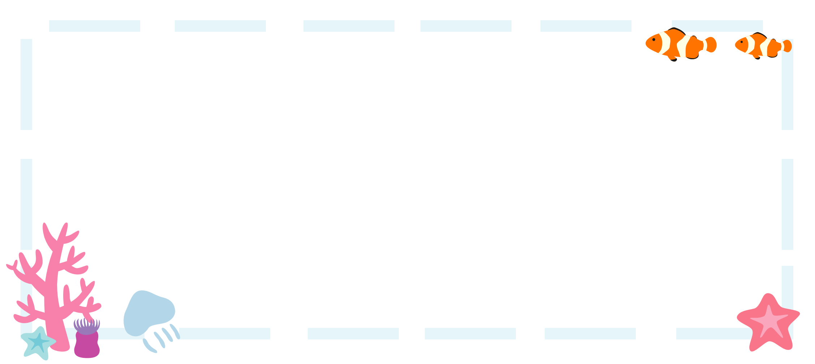
4.4 break语句
执行结果
Try to find first prime number(>=10000): 10000 checked, not prime number. 10001 checked, not prime number. 10002 checked, not prime number. 10003 checked, not prime number. 10004 checked, not prime number. 10005 checked, not prime number. 10006 checked, not prime number. First prime number(>=10000) is: 10007
//Project - BreakExample
#include <iostream>
using namespace std;
bool isPrime(int n) { ... }
int main(){
cout << "Try to find first prime number(>=10000):\n";
int iPrime = -1;
for (int i=10000;;i++){
if (isPrime(i)){
iPrime = i;
break;
}
cout << i << " checked, not prime number.\n";
}
cout << "First prime number(>=10000) is: " << iPrime;
return 0;
}
找出大于等于10000的第1个质数。

Slide 19
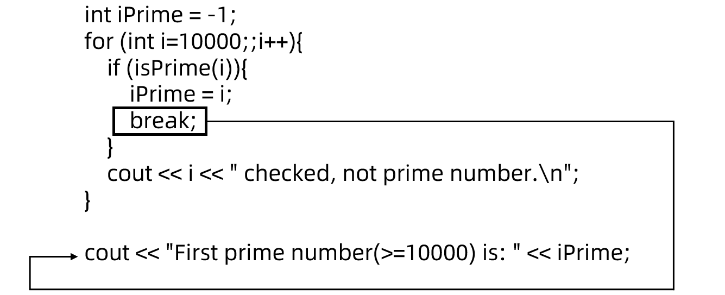
4.4 break语句

Slide 20

执行结果
Try to find all prime numbers(<=100): 2,3,5,7,11,13,17,19,23,29,31,37,41,43,47,53,59,61,67,71,73,79,83,89,97, 25 prime numbers been found.
4.5 continue语句
//Project - ContinueExample
#include <iostream>
using namespace std;
bool isPrime(int n) {...}
int main(){
cout << "Try to find all prime number(<=100):\n";
int iFound = 0; //发现的质数个数
for (int i=2;
i<=100;
i++){
if (!isPrime(i))
continue;
iFound++;
cout << i << ",";
}
cout << "\n" << iFound << " prime numbers been found.";
return 0;
}
找出并打印100以内的全部质数。

Slide 21
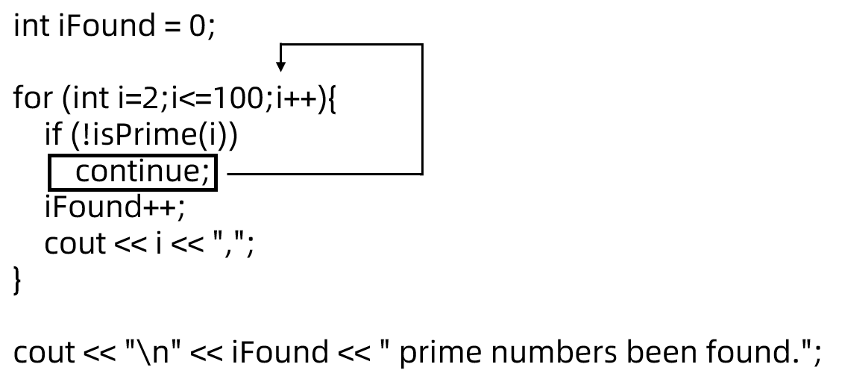
4.5 continue语句
continue的执行并不会结束整个循环，它只是略过本轮循环体的剩余代码，直接跳转至下一轮循环。

Slide 22

微实践 - 程序断点调试
在程序有缺陷，需要修复时，断点调试是发现缺陷的重要方法。对于初学者，断点调试还有另外一个用途：帮助理解程序背后的逻辑。

Slide 23

4.6 while循环
while (测试表达式)
语句;
while (测试表达式) {
语句;
...
语句;
}

Slide 24

执行结果
I am a parrot, say something to me. Good morning. Good morning. Run Forrest! Run Forrest! q q Bye, see you later.
4.6 while循环
//Project - Parrot1
#include <iostream>
#include <string>
int main(){
using namespace std;
cout << "I am a parrot, say something to me." << endl;
string s = "";
while (s!="q"){
getline(cin,s);
cout << s << endl;
}
cout << "Bye, see you later." << endl;
return 0;
}

Slide 25
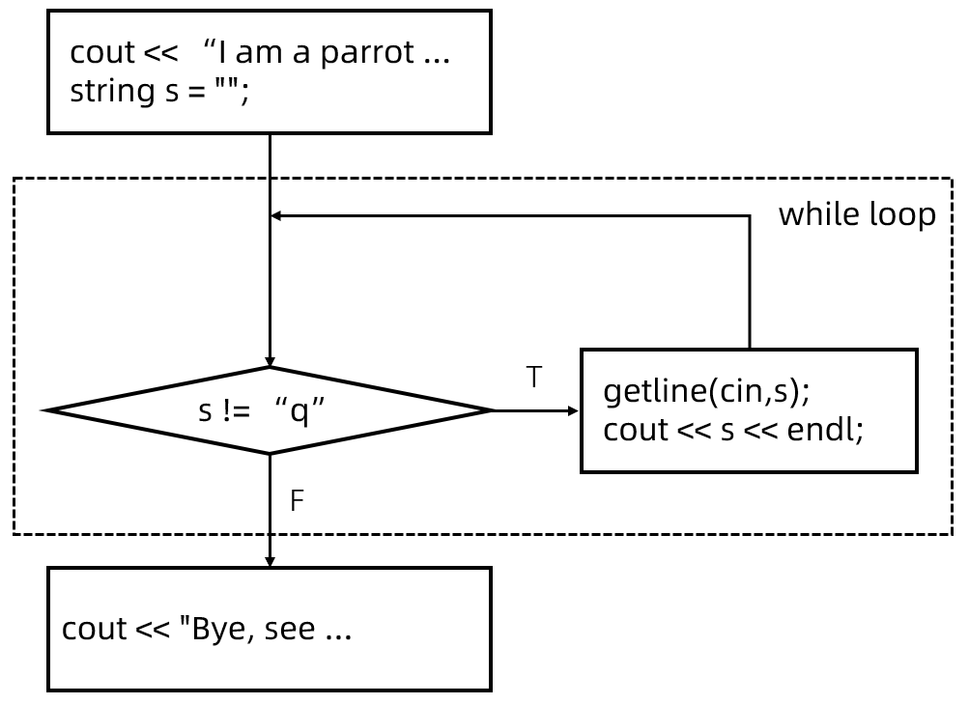
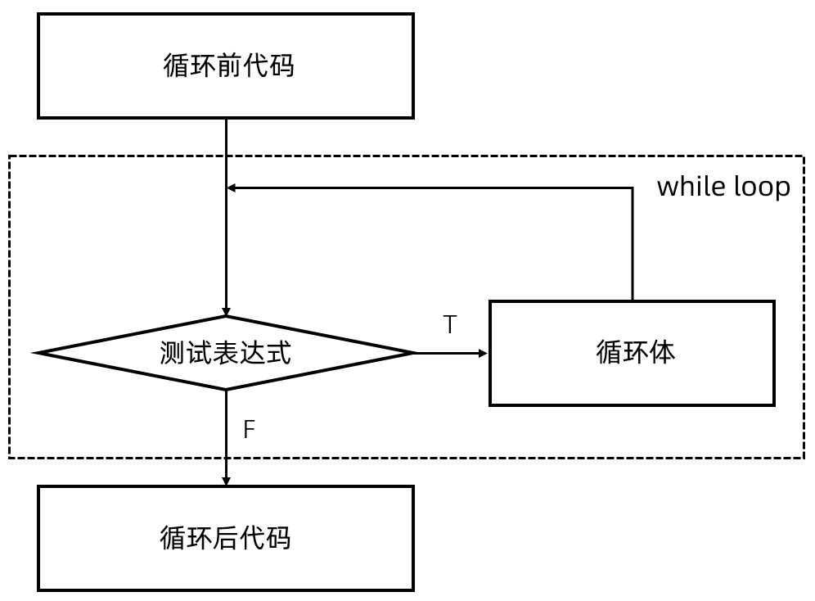
4.6 while循环
while循环先检查（测试表达式），后执行（循环体）

Slide 26
4.6 while循环
//Project - Parrot2
#include <iostream>
#include <string>
int main(){
using namespace std;
cout << "I am a parrot, say something to me." << endl;
string s = "";
while (true){
getline(cin,s);
if (s=="q")
break;
cout << s << endl;
}
cout << "Bye, see you later." << endl;
return 0;
}

Slide 27
微实践 - 九层之台，起于累土
//Project - Everest
#include <iostream>
using namespace std;
int main() {
int iCounter = 0; //对折次数
float fThickness = 0.0001F; //纸厚，单位米
while (true){
if (fThickness > 8844.43F) //超过珠峰高度就停止循环
break;
else{
fThickness *= 2; //对折一次厚度翻倍
iCounter++; //对折次数加1
}
}
cout << "Thickness = " << fThickness << " after "
<< iCounter << " folds, exceeding Everest.";
return 0;
}
合抱之木，生于毫末；九层之台，起于累土；千里之行，始于足下。
执行结果
Thickness = 13421.8 after 27 folds, exceeding Everest.

Slide 28
微实践 - 九层之台，起于累土
//Project - EverestSimple
#include <iostream>
#include <cmath> //引入log2()函数
using namespace std;
int main(){
double t = log2(8844.43/0.0001);
cout << t;
cout << endl << 0.0001 * pow(2,27);
return 0;
}
执行结果
26.3983 13421.8

Slide 29
执行结果
I am a parrot, say something to me. Good morning. Good morning. Run Forrest! Run Forrest! q q Bye, see you later.
4.7 do while循环
//Project - Parrot3
#include <iostream>
#include <string>
int main(){
using namespace std;
cout << "I am a parrot, say something to me." << endl;
string s = "";
do {
getline(cin,s);
cout << s << endl;
}
while (s!="q");
cout << "Bye, see you later." << endl;
return 0;
}

Slide 30
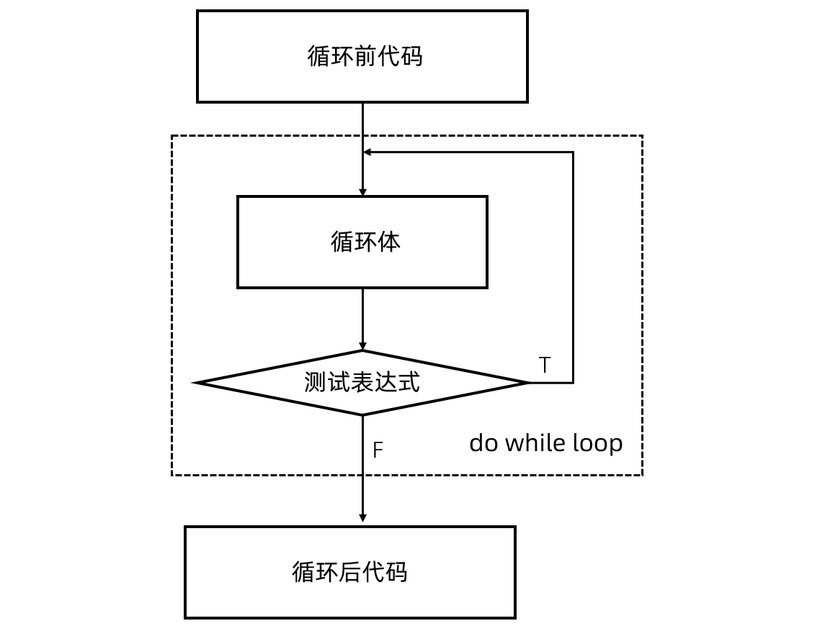
4.7 do while循环
先执行（循环体），后检查（测试表达式）

Slide 31

4.8 switch分支
switch (整数表达式) {
case 标签1:
...
case 标签k:
语句(一条或多条);
break;
...
case 标签n：
语句(一条或多条);
break;
default:
语句(一条或多条);
}

Slide 32
执行结果
Please input month number(1~12):7 There are 31 days in 7th month.
4.8 switch分支
//Month
#include <iostream>
using namespace std;
int main() {
int iMonth = 1;
cout << "Please input month number(1~12):";
cin >> iMonth;
switch (iMonth){
case 1: case 3: case 5: case 7: case 8: case 10: case 12:
cout << "There are 31 days in " << iMonth << "th month.\n";
break;
case 2:
cout << "There are 28 or 29 days in " << iMonth << "th month.\n";
//break; //break缺失
case 4: case 6: case 9: case 11:
cout << "There are 30 days in " << iMonth << "th month.\n";
break;
default:
cout << "Wrong month number.\n";
}
return 0;
}
执行结果
Please input month number(1~12):2 There are 28 or 29 days in 2th month. There are 30 days in 2th month.
执行结果
Please input month number(1~12):19 Wrong month number.

Slide 33

4.9 goto语句*
C++中的goto语句用于跳转程序的执行点至指定位置。从效率上看，goto很高效，从软件工程角度，goto语句的使用容易导致程序逻辑混乱、变得难以理解和维护。
//Project - GotoExample
#include <iostream>
using namespace std;
int main(){
int i {1};
int sum {0};
loop:
sum += i;
i++;
if (i<=100)
goto loop;
cout << "sum = " << sum << endl;
return 0;
}
Linux内核中大量使用goto语句

Slide 34
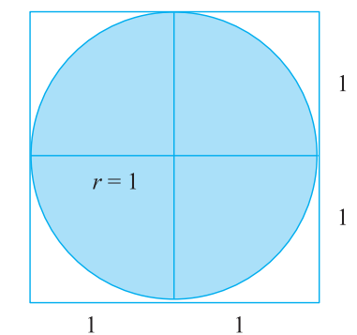
微实践 - 发现圆周率
π = 内切圆的面积

Slide 35
执行结果
pi = 3.1464
微实践 - 发现圆周率
//Project - FindPi
#include <iostream>
#include <cmath>
using namespace std;
int main() {
const int N = 1000000; //投点总数
int nHits = 0; //圆内投点数
for (int i=0;i<N;i++){
double x = 2.0*rand()/RAND_MAX - 1.0; //随机数取投点x坐标
double y = 2.0*rand()/RAND_MAX - 1.0; //随机数取投点x坐标
if (x*x + y*y <= 1.0) //投点位于内切圆内
nHits += 1; //圆内投点数+1
}
double pi = 4.0*nHits/N; //通过计算圆面积估算圆周率
cout << "pi = " << pi;
return 0;
}
因为随机数的关系，运行结果每次都不同。一般说来，N约大，结果越准确。

Slide 36
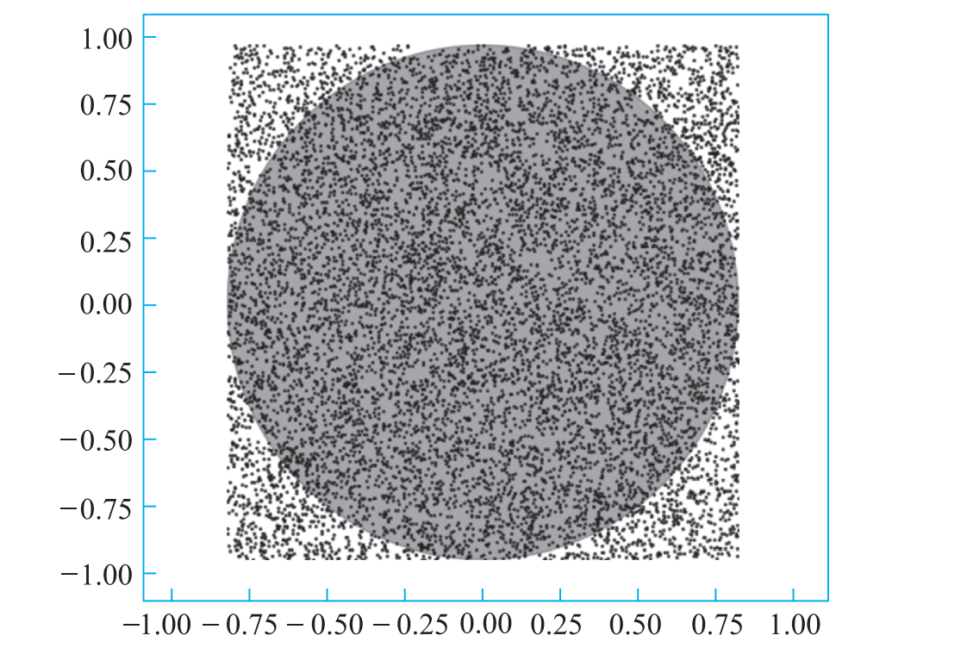
微实践 - 发现圆周率

Slide 37
End of Chapter 4
重庆大学 海洋饼干叔叔

